Slide 1
Coin API
5/2/2018

Slide 2
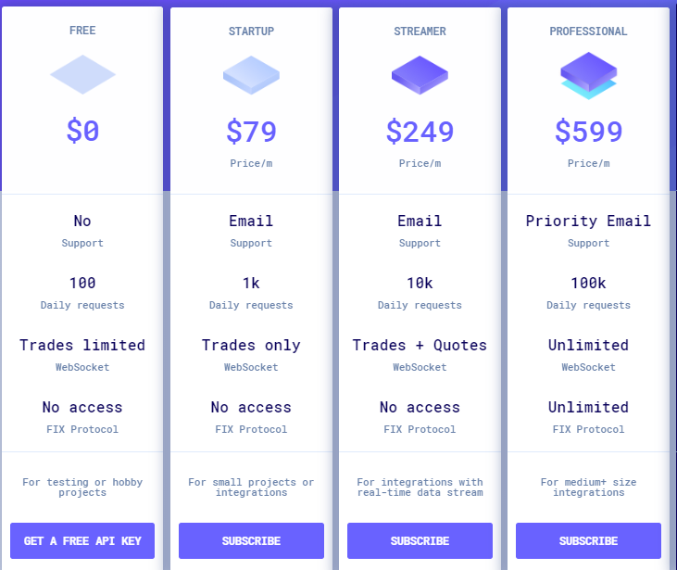
CoinAPI.io
https://docs.coinapi.io/#rest-api

Slide 3
CoinAPI.io (Con’t)
Bitstamp, GDAX, Kcoin, kraken, and POLONIEX 등을 Single API로..
RESTful, WebSocket, FIX
다양한 언어 JAVA, obeject-c, C++, Node.js 등등등
현재 RATE (time, rate)
OHLCV (Open, High, Low, Close, Volume)
List all periods
Latest data
Historical data

Slide 4
cryptocompare
https://www.cryptocompare.com/api/?javascript#introduction
Single API
Free

Slide 5
coinmarketcap
https://coinmarketcap.com/api/
FREE
Percent change : 1h – 24h – 7d
Valid cryptocurrency values are: "BTC", "ETH" "XRP", "LTC", and "BCH“
Valid fiat currency values are: "AUD", "BRL", "CAD", "CHF", "CLP", "CNY", "CZK", "DKK", "EUR", "GBP", "HKD", "HUF", "IDR", "ILS", "INR", "JPY", "KRW", "MXN", "MYR", "NOK", "NZD", "PHP", "PKR", "PLN", "RUB", "SEK", "SGD", "THB", "TRY", "TWD", "ZAR"

Slide 6
GDAX
https://docs.gdax.com/#api

Slide 7
BITTREX
https://support.bittrex.com/hc/en-us/articles/115003723911

Slide 8
Kraken
https://www.kraken.com/help/api

Slide 9
Waves Data Feed API
http://marketdata.wavesplatform.com/

